Slide 1
Introduction to Physical Computing
Julia Makivic
Notes:
Welcome to Introduction to Physical Computing! Where we will learn how to create computational systems embedded in physical objects.

Slide 2
What is physical computing?
Physical computing involves creating computational systems that respond to human and/or environmental inputs.
These inputs can be used to affect the behavior of software or hardware such as motors, lighting and other electro-mechanical devices.
Physical computing provides a means of interacting with a computational system that extends beyond standard inputs like mouses, keyboards and touch screens. It provides an alternative platform for examining how humans can relate to digital systems.

Slide 3
How about you?
How would you like to integrate physical computing into your creative practice?

Slide 4
What will you be learning?
Programming sensors with Arduino
Principles of material interaction design
The history of haptic and tactile machine interfaces
Prototyping and project scoping strategies

Slide 5
Projects and Deliverables
Ungraded weekly assignment
Extension of your lab work. How can you use what you learned in lab to make something cool?
Sketches, prototypes, visualizations of something that you can do with the techniques you learned in lab
Spend at least 2 hours per week on it
We will discuss these assignments at the start of each class
Final project at the end of the term
Notes:
Notes: doublecheck what the final term deliverable is - provide more concrete information on it

Slide 6
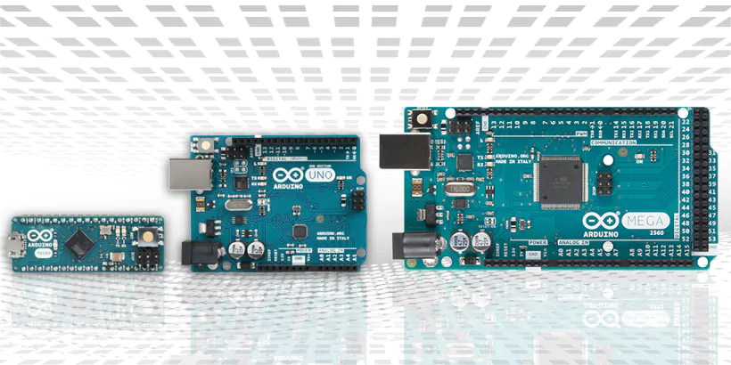
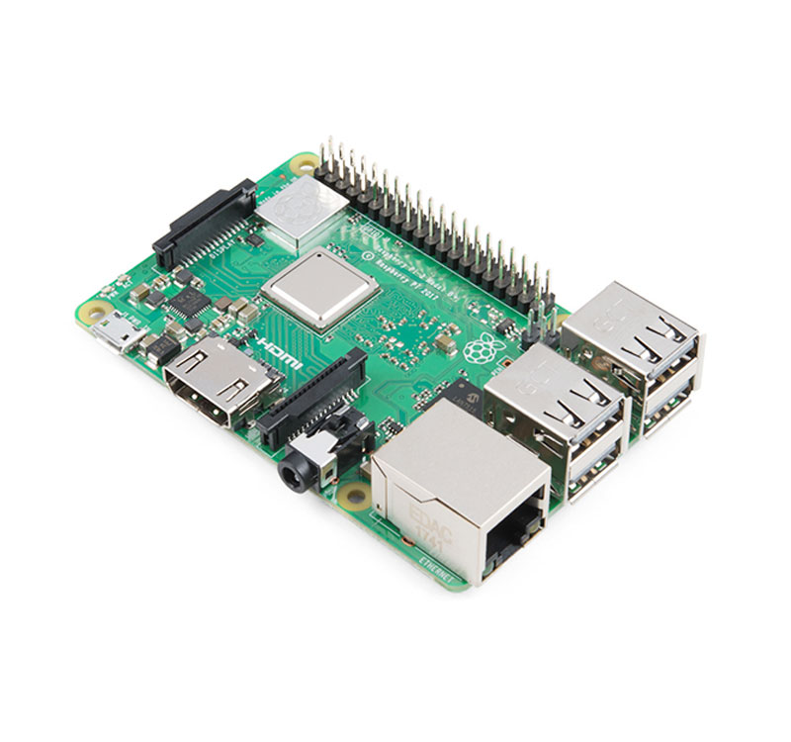
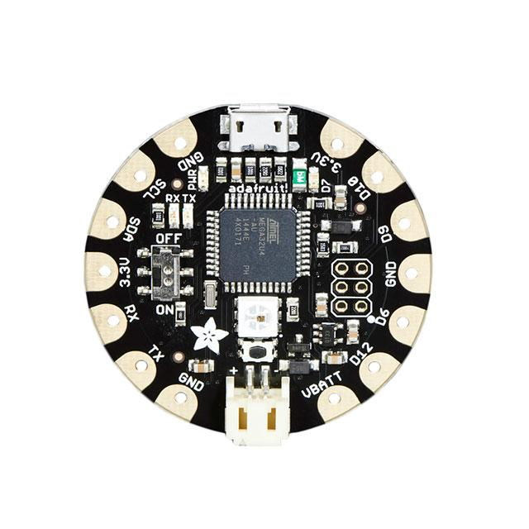
Overview of Physical Computing Tools
Raspberry Pi
Arduino
Adafruit FLORA
(Wearables)

Slide 7
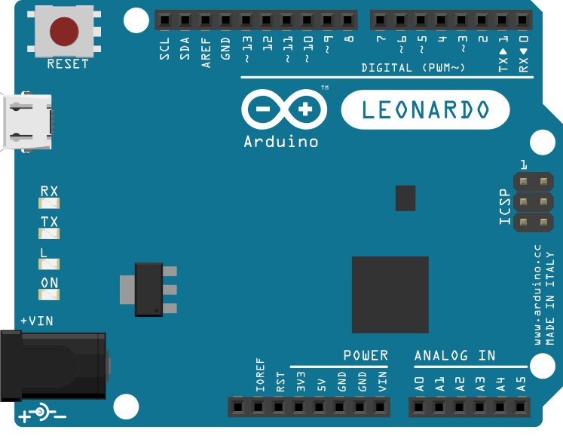
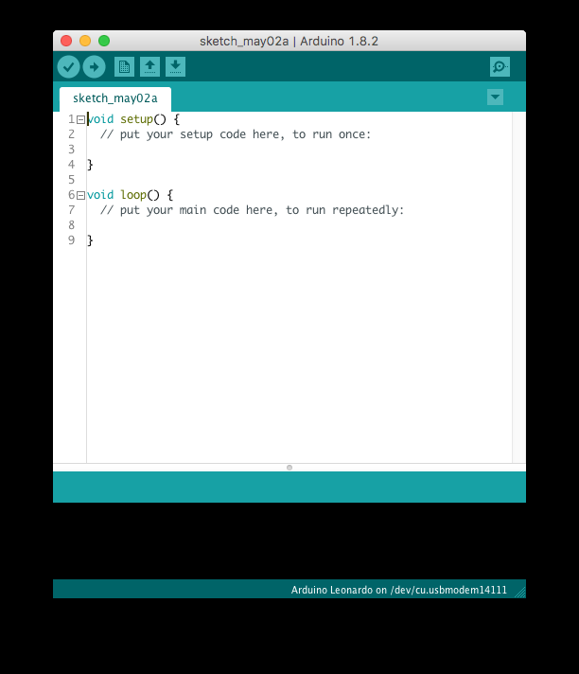
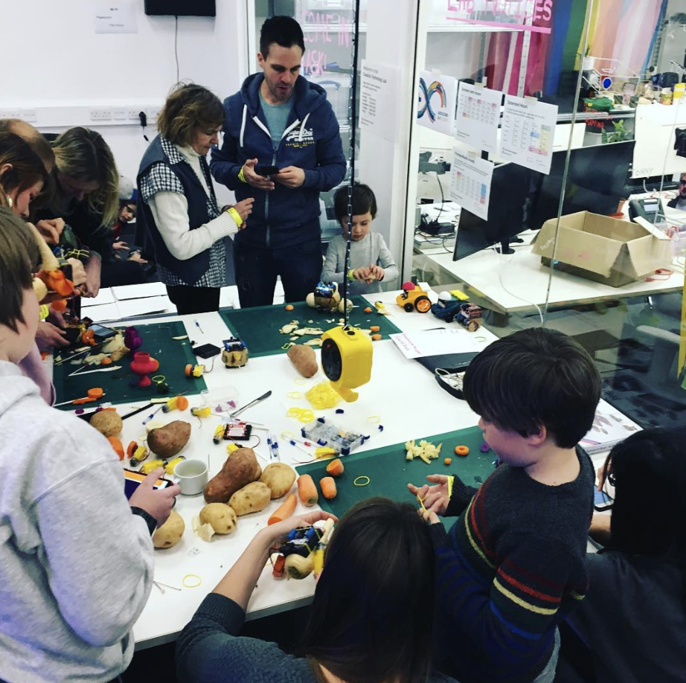
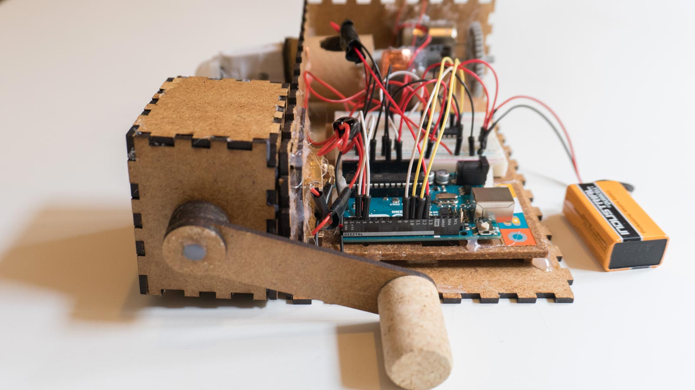
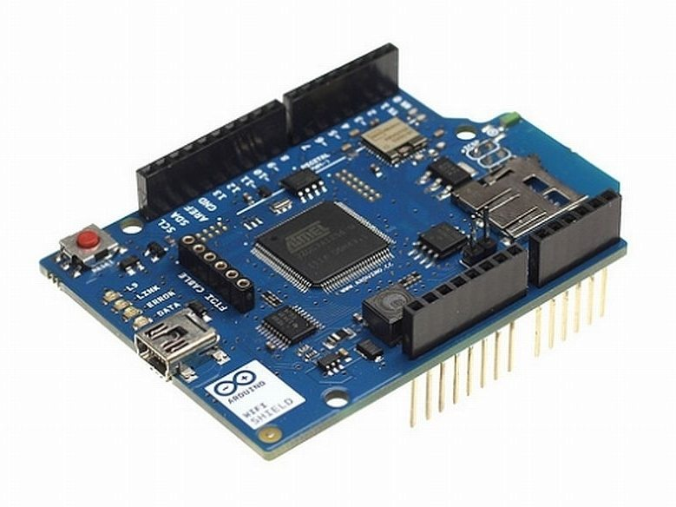
Arduino
Notes:
Go over these points, but spend some time talking about the anatomy of an arduino

Slide 8
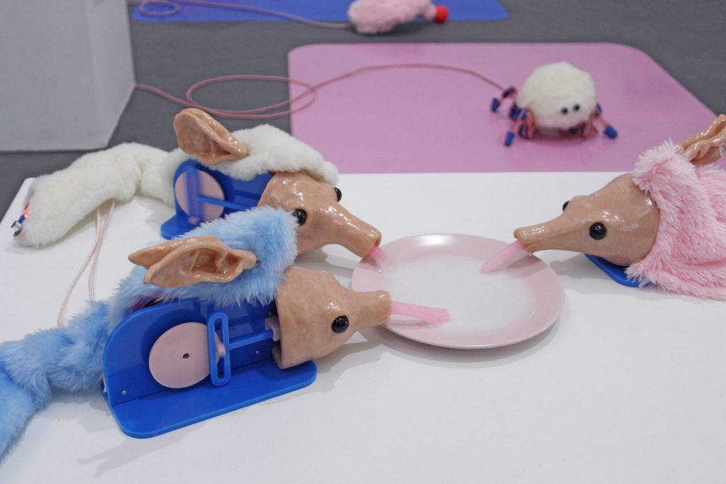
The Uncanny Dimple
Video
By Eevi Rutanen

Slide 9
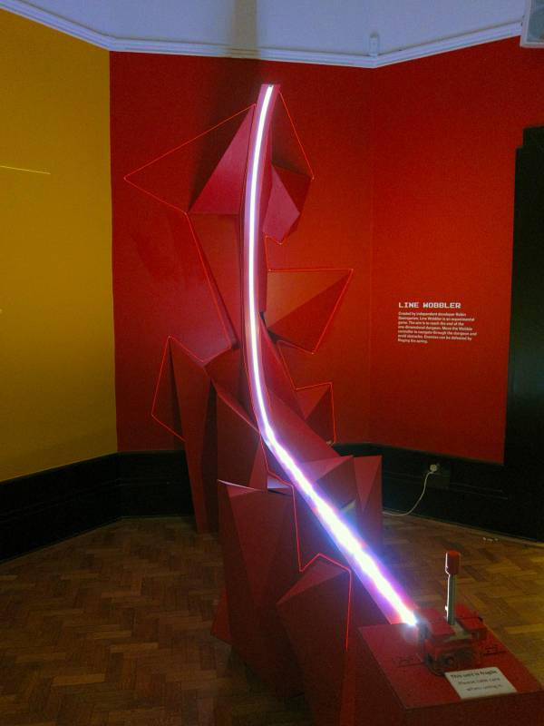
Line Wobbler
Line Wobbler
Video
By Robin Baumgarten

Slide 10
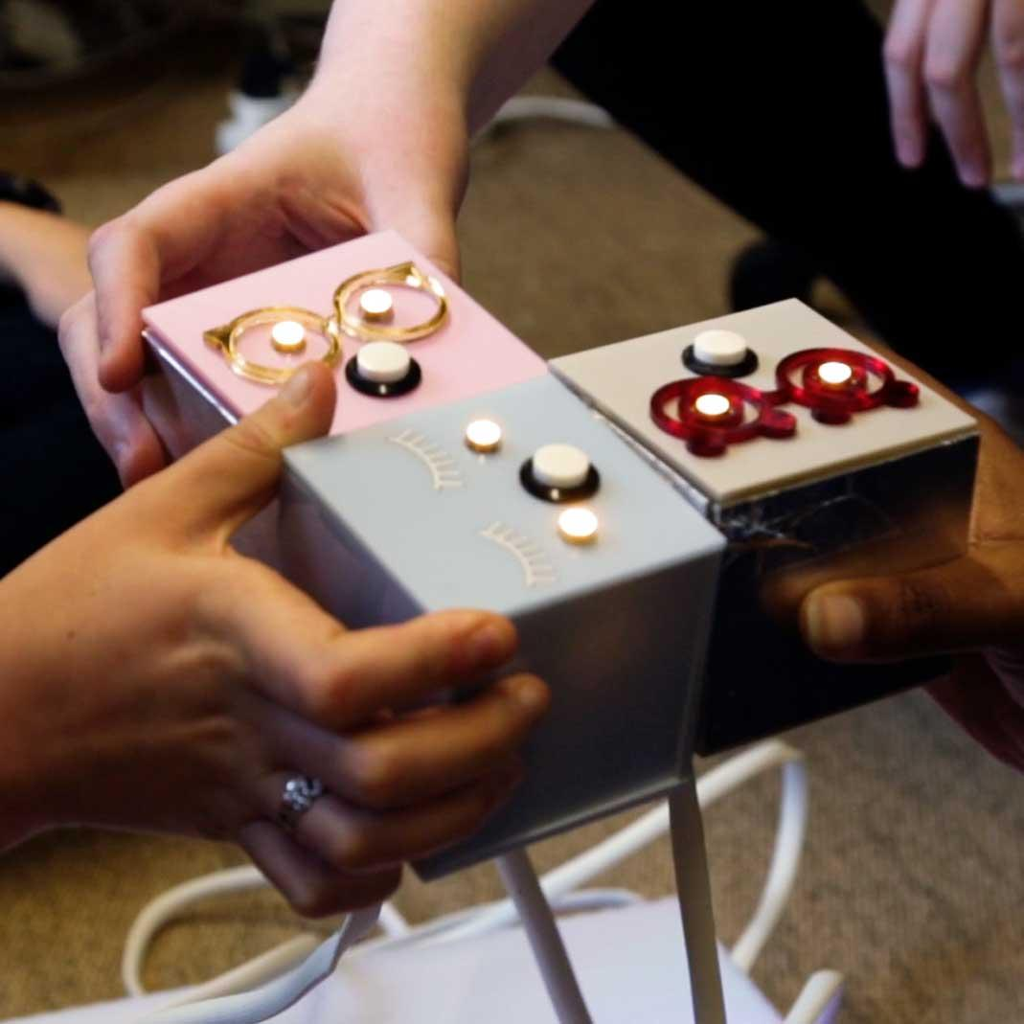
Bot Party
By Phoenix Perry
Video

Slide 11
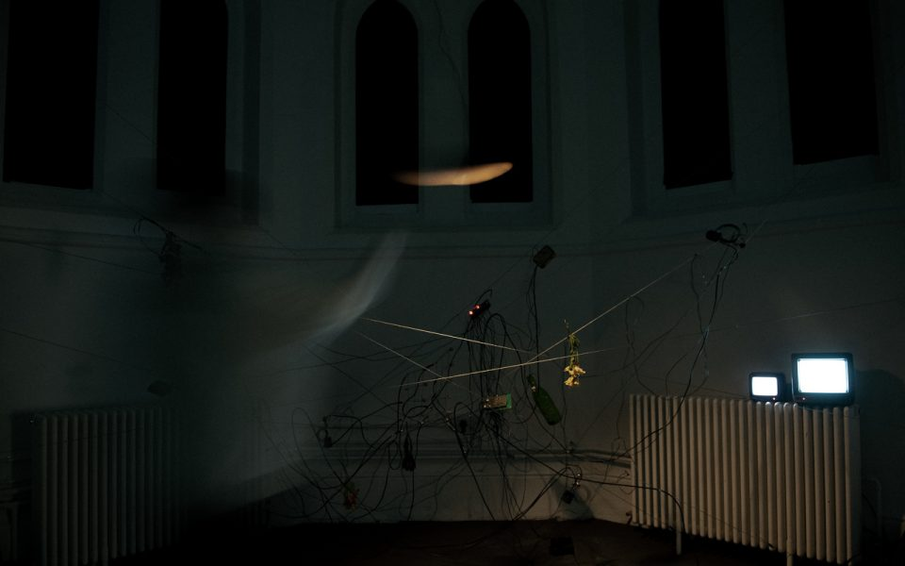
Every
By Annie Tådne
Video

Slide 12
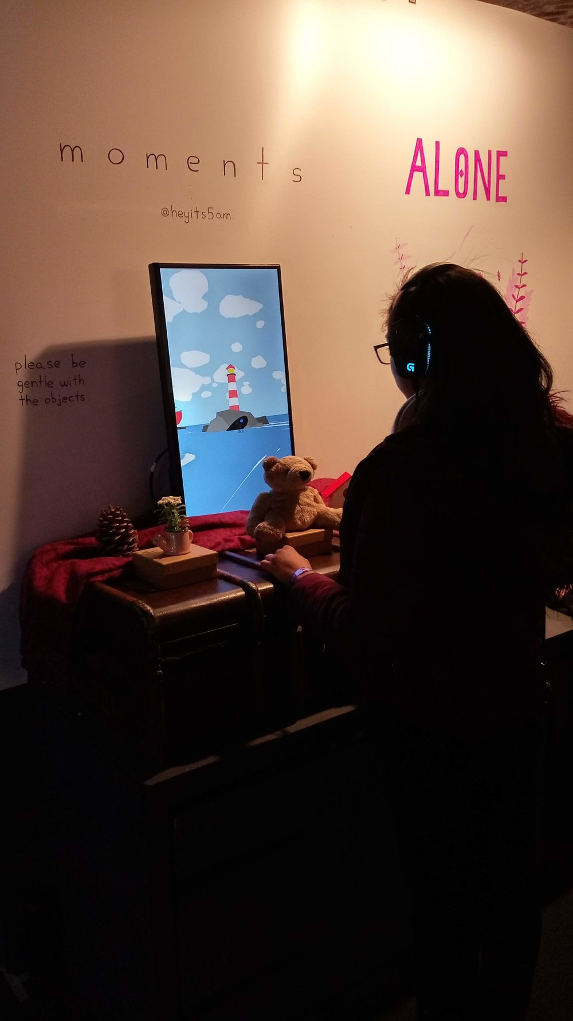
moments
By Sam Wong
Video

Slide 13
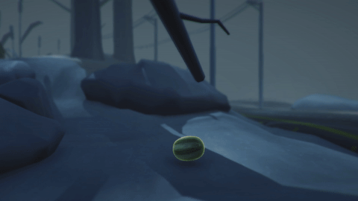
The Revolutionary Watermelon that Wanted to Live Free as a Bird and Learned How to Escape
Video
By SpaceBackyard

Slide 14

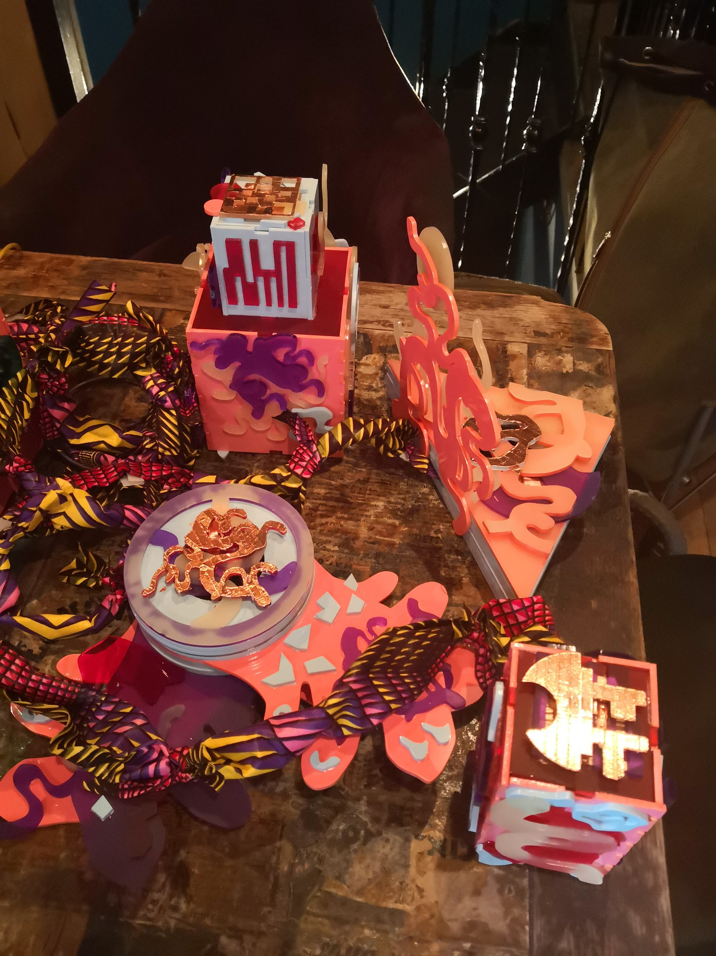
Void of Memory
Narrative game made using Arduino Mega, TFT LCD screen, tilt switches, various conductive surfaces.
Notes:
I am an artist who makes alternative controller videogames! Physical computing is central about me.

Slide 15
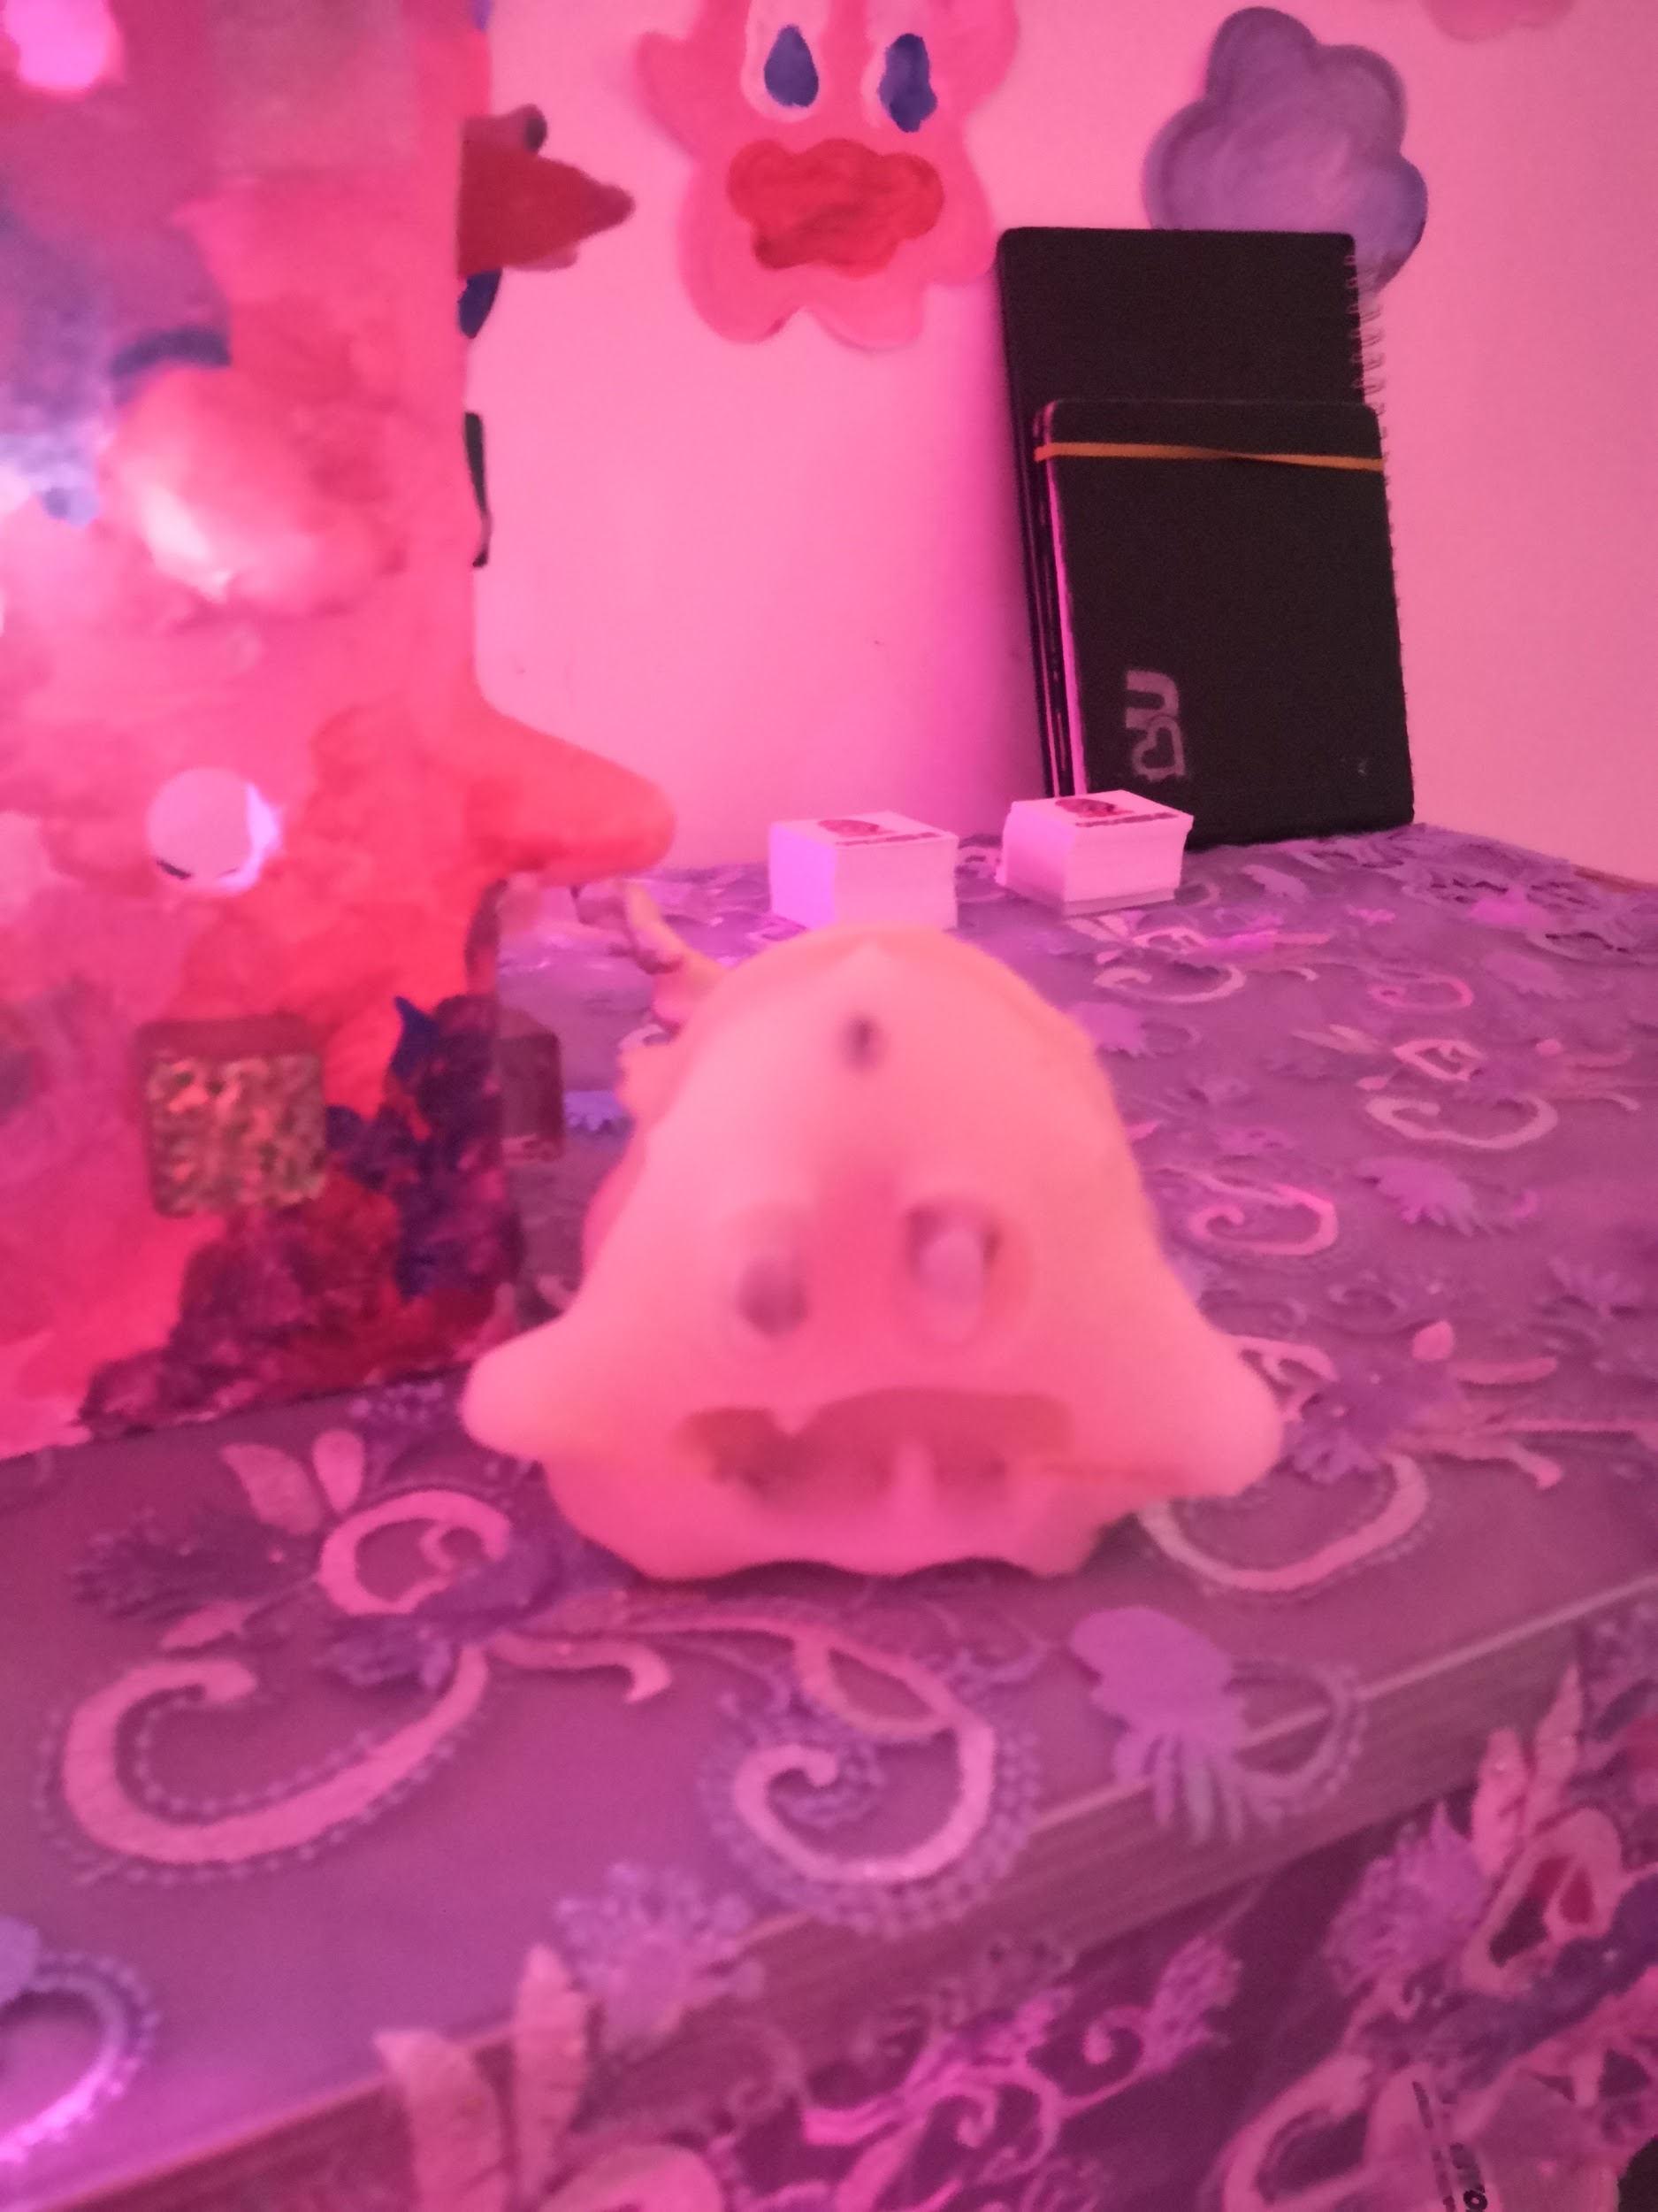
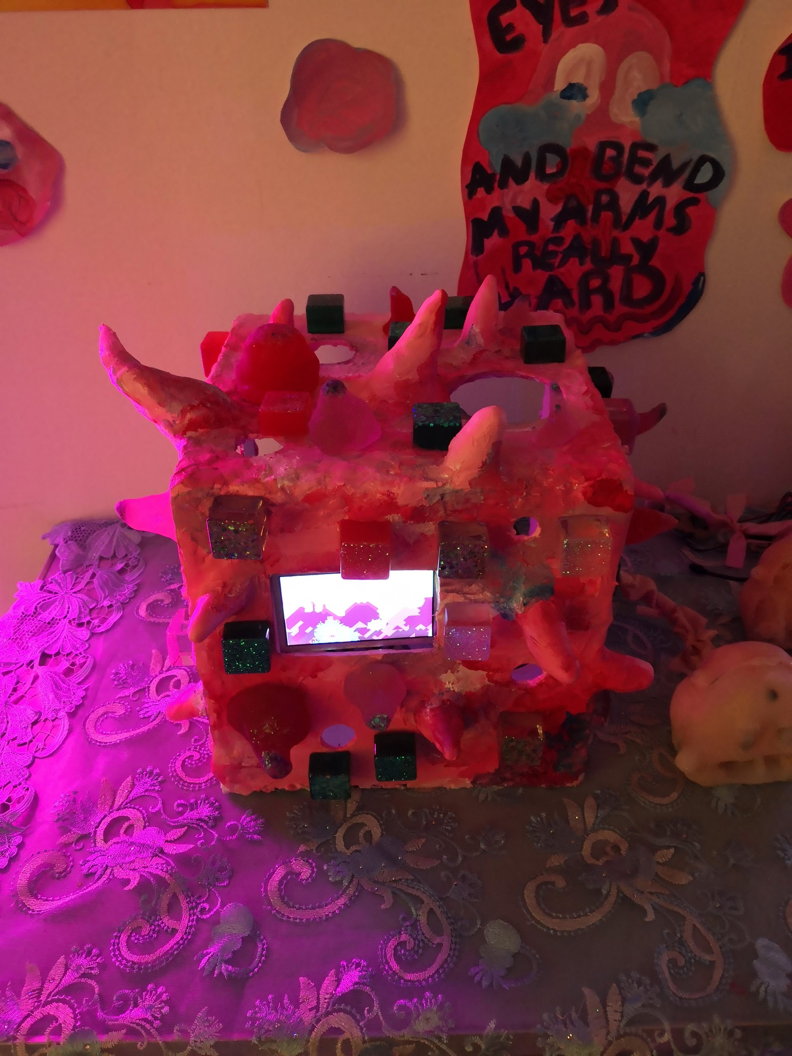
Ghostboi in the Land of the Dead
Narrative game with ghost-shaped controller! Tilt switches, conductive materials and vibration motors embedded in silicone, powered by a Raspberry Pi.

Slide 16
==Break==

Slide 17
Lab: 12/11/2019
Go over basics of electricity
Switches and resistors
Lab exercises
Homework

Slide 18
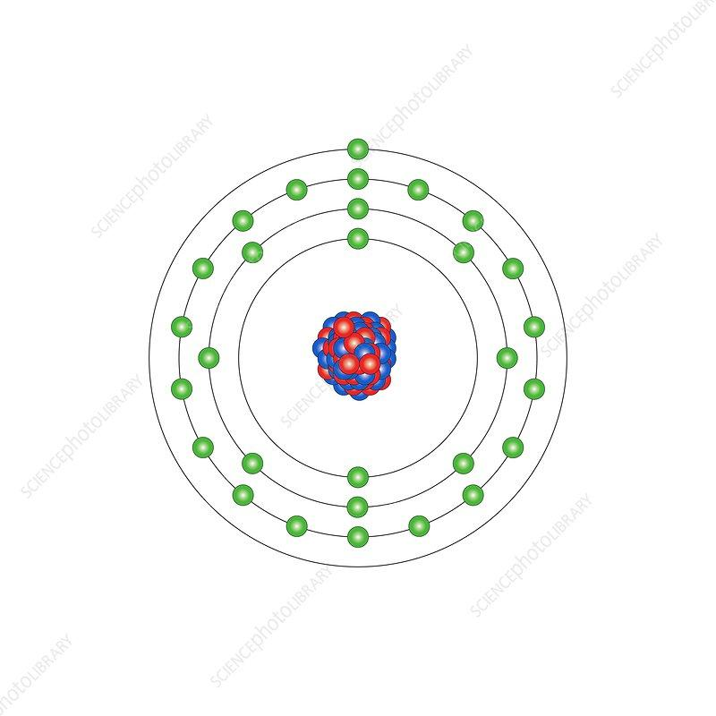
What is electricity?
Electricity:
Electrical current is the flow of electrons
When the valence electron of an atom is bombarded with sufficient energy to leave its current orbit, it will move to hit other electrons
The movement of electrons is what creates a current and is commonly referred to as electricity
Electrical current is measured in Amperes (Amps), using an A symbol

Slide 19
Conductors vs. Insulators
Conductor: Have atoms with fewer electrons in their outer orbit
As a result, they are more unstable and will lose their electrons when hit by current
Copper atoms only have one electron in their outer orbit
Current moves easily through the conductive material
Insulator: A material that does not let go of its electrons so easily
Current has a difficult time flowing through insulators
Plastics/rubber are insulators

Slide 20
What is an electrical circuit?
An electrical circuit is the path along which electrons move.
It is the path through which electric current flows
Electric current requires a power source
Electrons flow from the power source, along the path and return to the source
Voltage measures the change in energy from one point in the circuit to another
Measured in Volts, uses V symbol
Resistance measures how much a component resists the flow of electrical energy
Measured in Ohms, uses Ω

Slide 21
Electrical circuits (cont. . .)
There needs to be a complete path from the energy source (power) to the point of least energy (ground) in order to make the circuit.
If the path is broken or incomplete the circuit won’t work
All of the electrical energy in a circuit gets used up by the components in it and gets converted into another type of energy (light, sound, heat)

Slide 22
Resistance
Electrical current will seek the path of least resistance to ground
If there is no resistance between the power source and ground, there will be a short circuit
The electrical energy gets converted into light and heat, potentially resulting in sparks or an explosion
Resistors slow down the flow of current in the circuit, decreasing the amount of energy reaching ground or a component
Resistors convert the electrical energy into heat
They are in between a conductor and an insulator

Slide 23
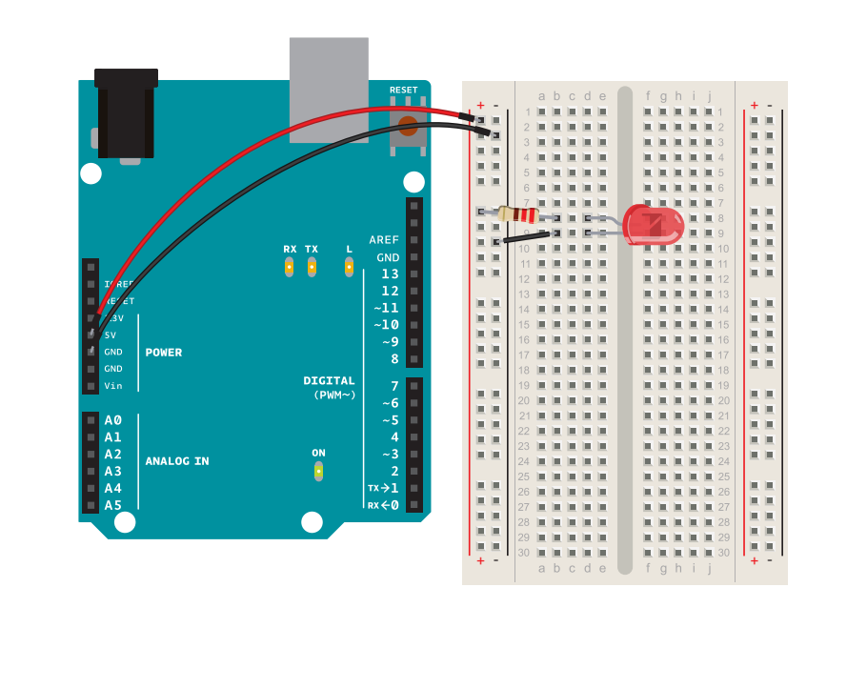
Let’s build some circuits!

Slide 24
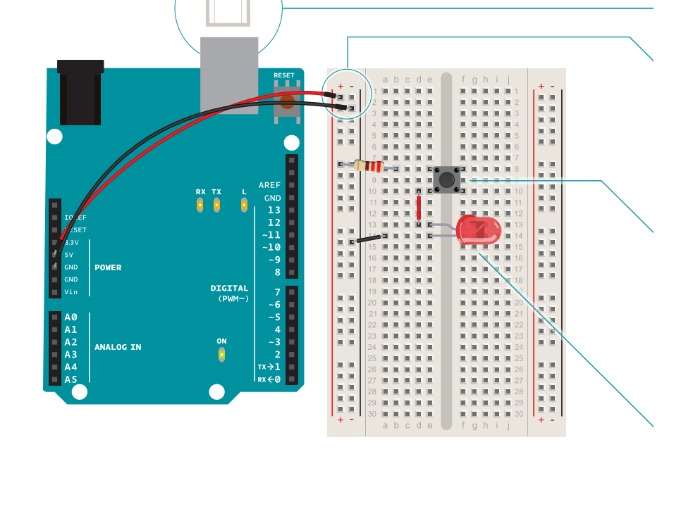

Slide 25
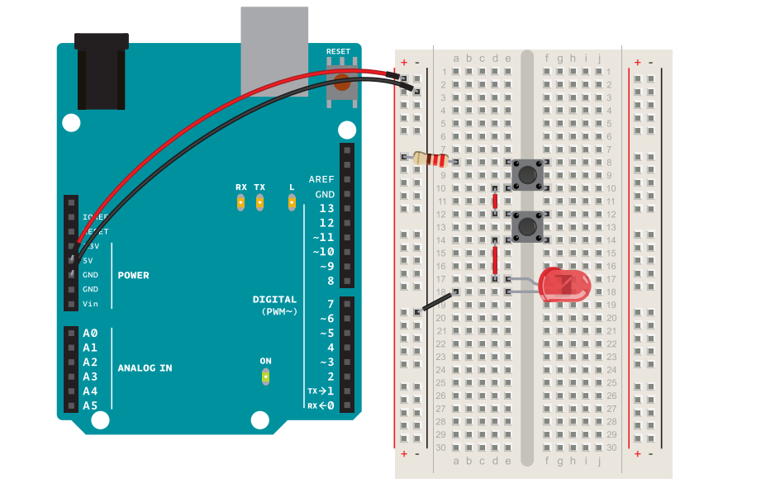
Series Circuit
The same electrical current flows through both switches.
They both need to be closed (pressed) in order for the current to flow through them.

Slide 26
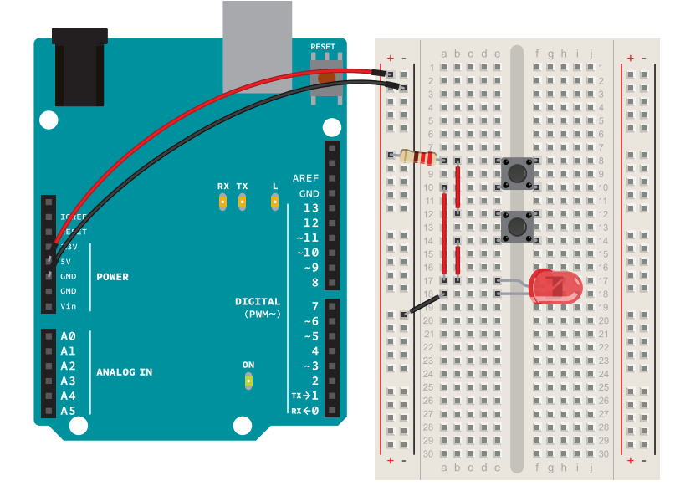
Parallel circuit
The electrical current is split between the two switches.
Only one of them needs to be pressed in order for the LED to light up.

Slide 27
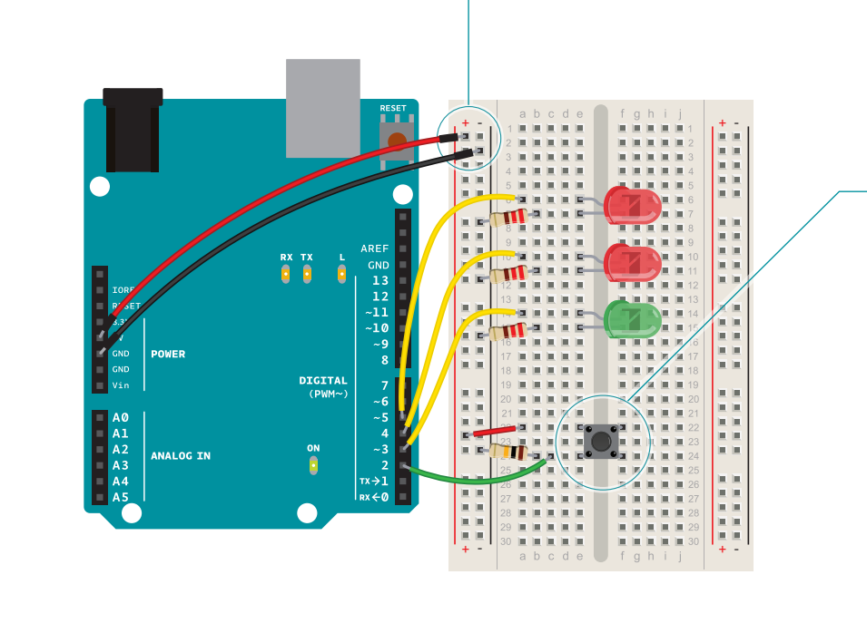
Spaceship Interface

Slide 28
Experiment: Spaceship Interface, but with a ~~Tilt Switch~~!

Slide 29
Homework
Github page with class info: https://github.com/jmakivic/cci-pcomp-fall2019
Assignment:
Think of how you can expand on the “Spaceship Interface” exercise in the Arduino Projects book. How could you make an engaging interactive project using a few LEDS, a pushbutton and/or a tilt switch? Next week bring sketches/designs or prototypes of your ideas.

